Slide 1
Rapid Miner

Slide 2
Index
1、Basic introduction
2、Interface introduction
3、Import Data
4、Extended application
5、data presentation
6、Build simple models
7、Partition data set
8、Cross Validation
9、Titanic example from kaggle

Slide 3
Basic introduction
Notes:
Rapidminer functions are realized by connecting various operators to form a process. The whole process can be regarded as the production line of the factory workshop, which inputs the original data and model results. An operator can be regarded as a function that performs a specific function. Different operators have different input and output characteristics.

Slide 4
Interface introduction

Slide 5
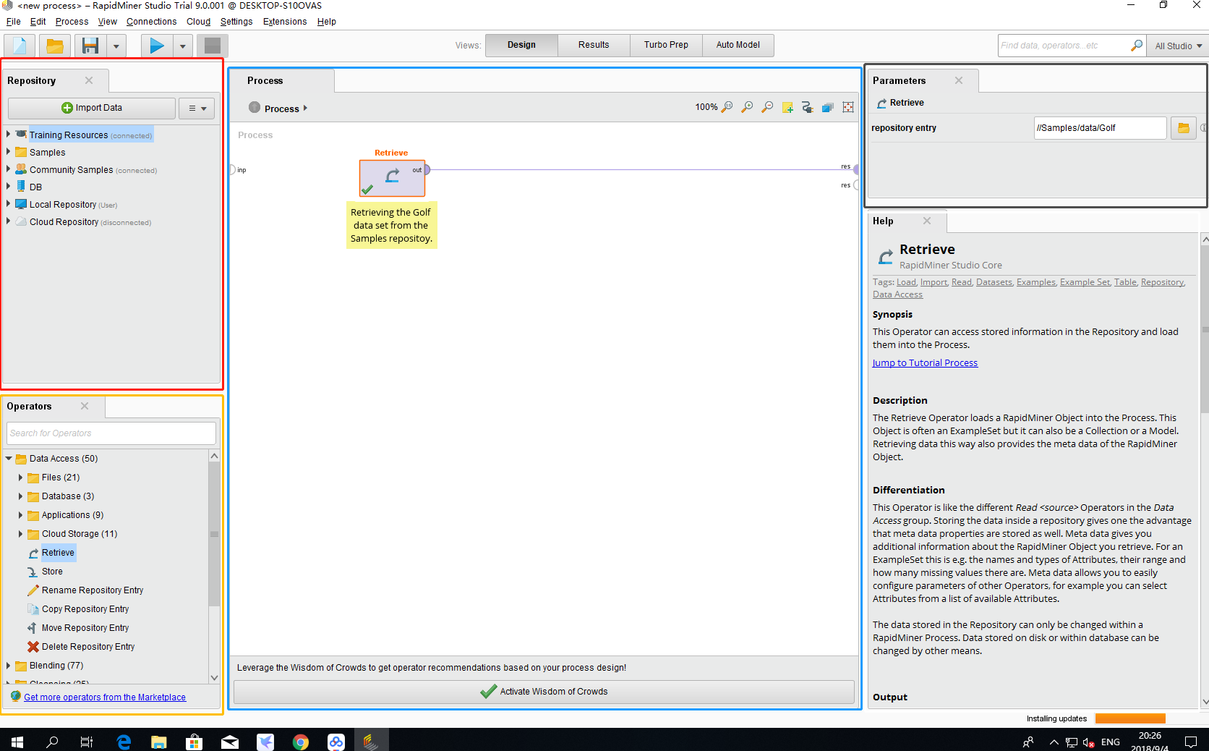
Notes:
The red part on the left is mainly where some data is stored; The part marked in yellow in the lower left corner is some operators. After finding the required operators, you can directly drag and drop them into the middle "Process" area. The middle area is the processing area, where you can view the model you built and some results of the operation. The area marked by gray in the upper right corner is the place where parameter information is displayed. In the lower right corner is the help window. If you don't know how to use the selected operator, you can click the operator and the help information will be displayed in the window.

Slide 6
Import Data

Slide 7
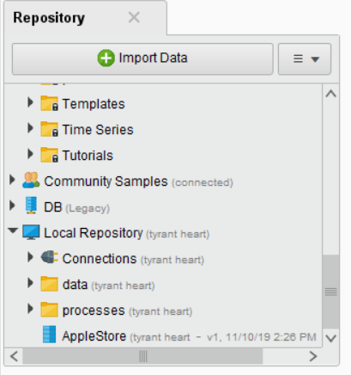
Two method to import your data to the rapid miner:
1、Directly drag the data(.csv,.xlsx….) into the Process
2、Click the imort data button

Slide 8
Extended application

Slide 9
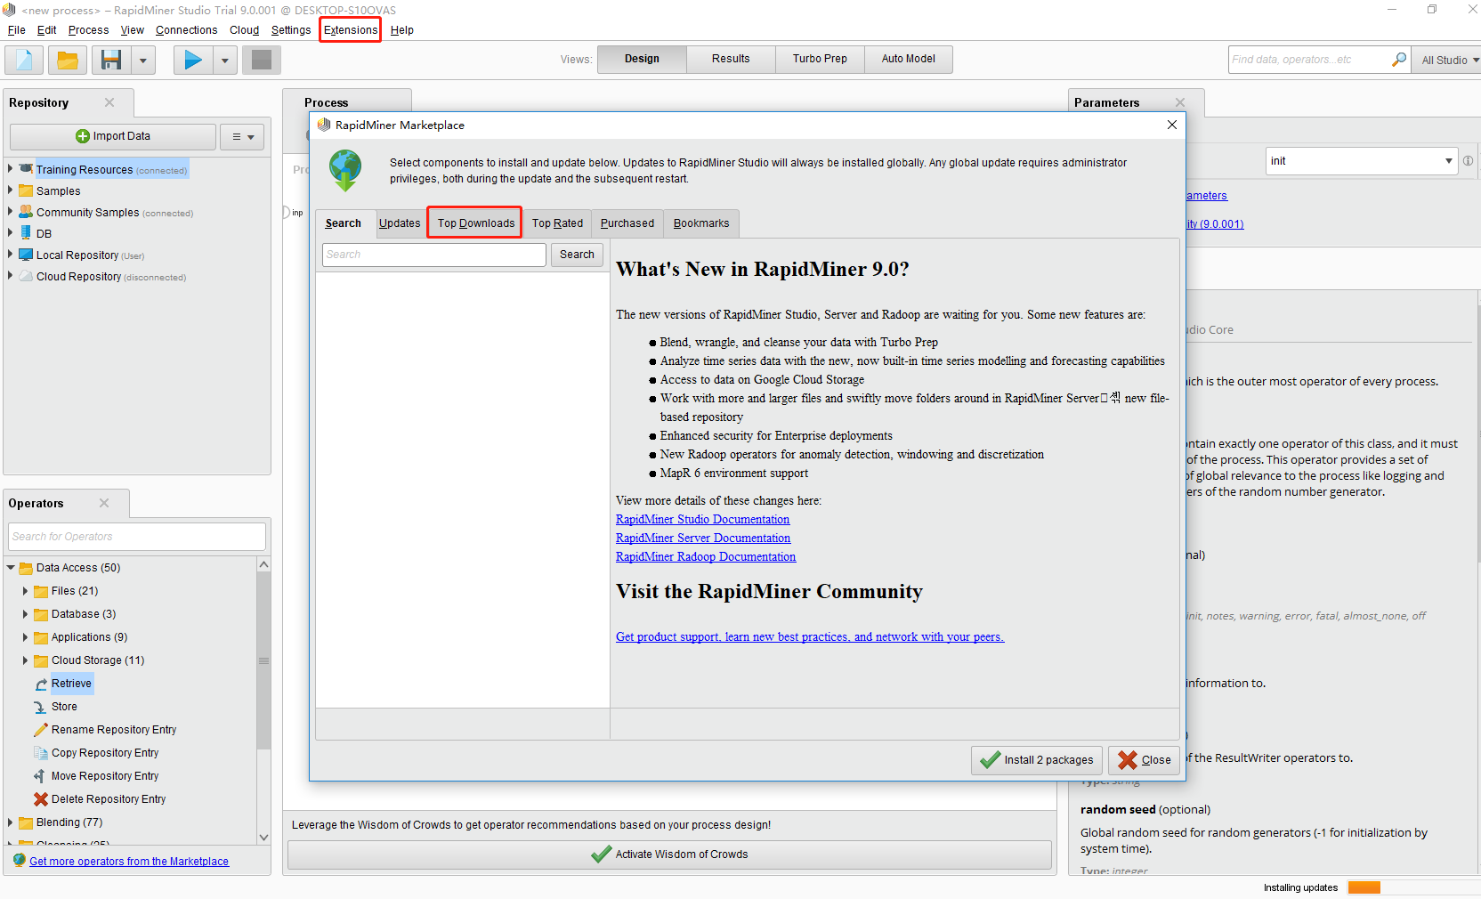
Notes:
Click Extensions at the Top of the screen and click Top Downloads to see a number of Extensions. Initially there will be a short period of update load time.

Slide 10
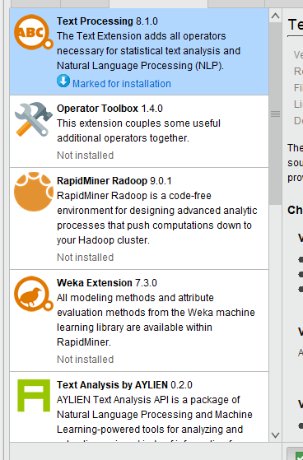
Here are the extensions: "Web Processing," "Text Processing," and so on

Slide 11
data presentation

Slide 12
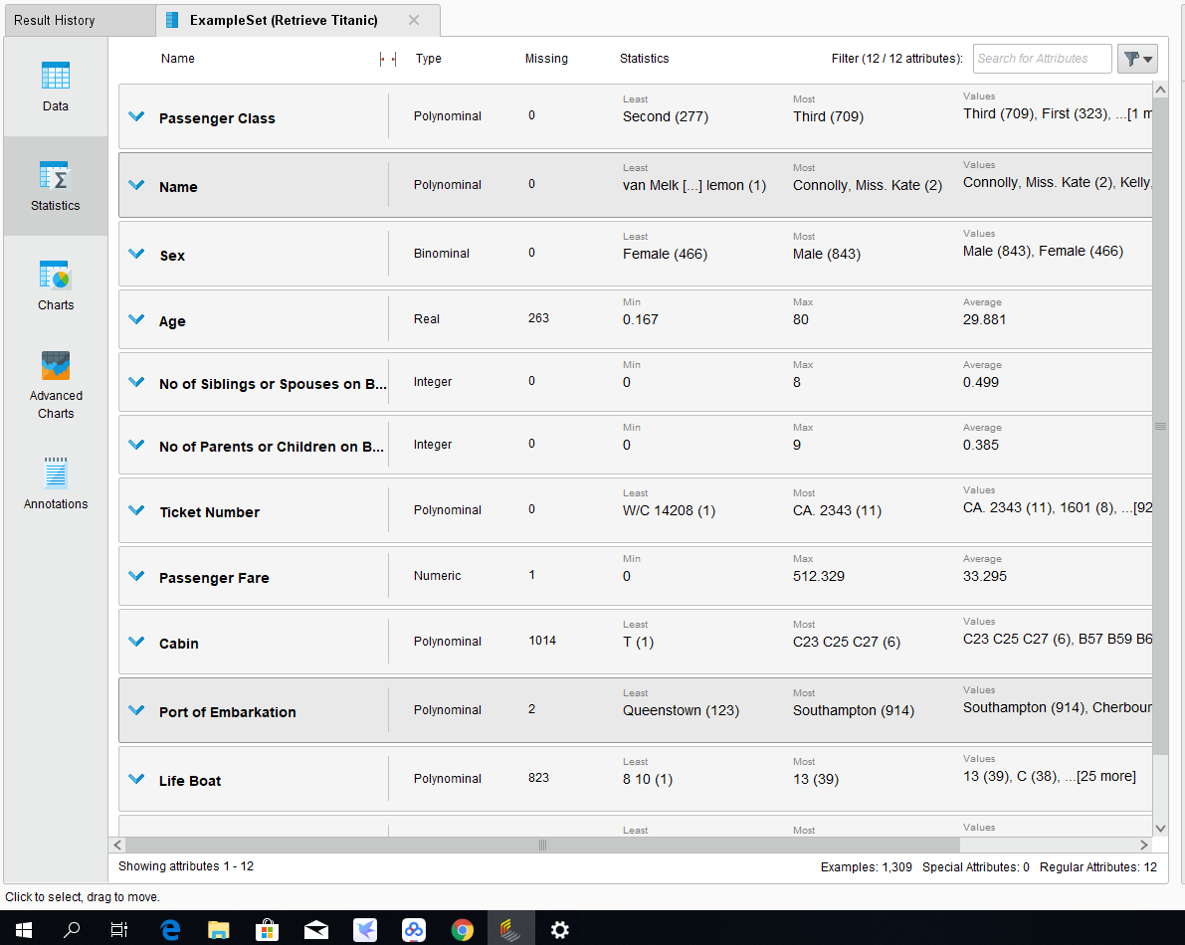
Notes:
Double-clicking on any data set brings up the following window. The "Data" column shows the raw Data; The column "Statistics" shows some Statistics of the data. The columns "Charts" and "Advanced Charts" display some Charts of data for visualization.

Slide 13
Build simple models

Slide 14
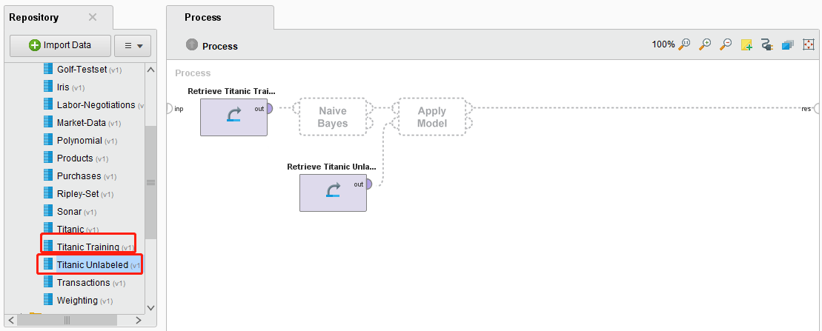
Into the data
Notes:
Into the data,In the "Data" of "Samples", "Titanic Training" and "Titanic Unlabeled" were found respectively for Training model and test model. The former is processed data that has been filtered out of useless information, and the latter is unlabeled data.

Slide 15
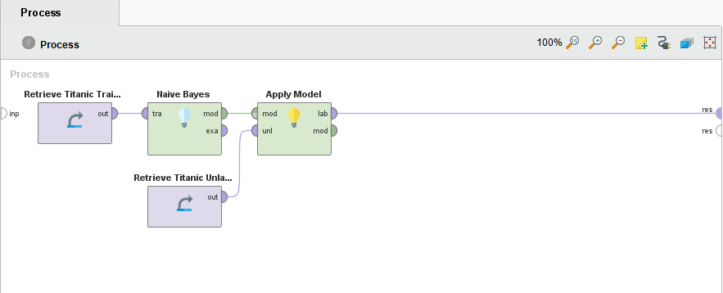
Final design
Notes:
Selection modelUnder "Operators", you can search under the search box for the desired model. For this example, select the "Naive Bayes" model and drag it to the right action bar.Application modelTo use the trained Model for prediction, the operator "Apply Model" is needed. Also search the search box and drag it into the right action bar.runAfter connecting the data to the operator, click the run button.

Slide 16
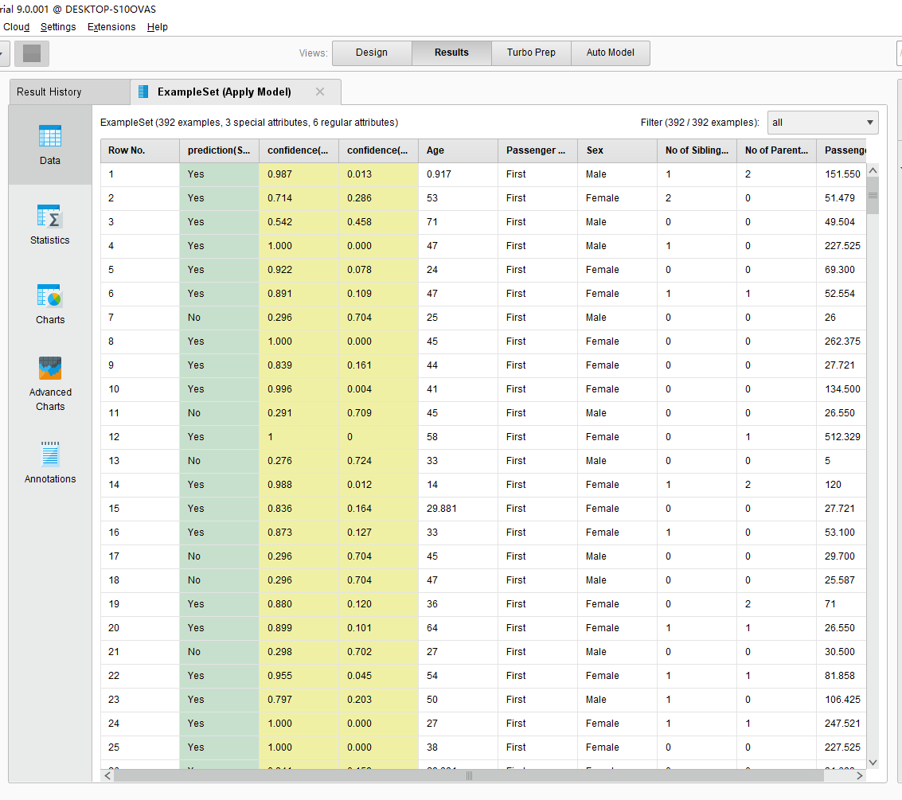
Result

Slide 17
Partition data set

Slide 18
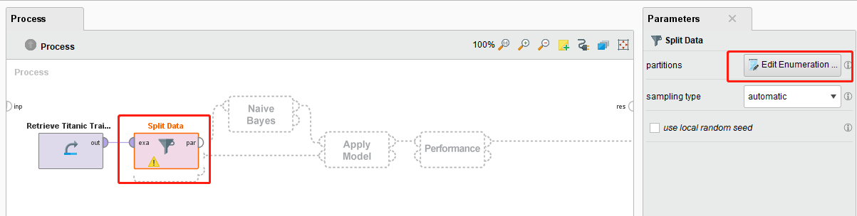
Put the split operator
Notes:
Under the search box under "Operators", search for "Split Data" and drag it into the right action bar. Then click on the operator, and some information appears in the rightmost "Parameters" column. Click "Edit Enumeration" and

Slide 19
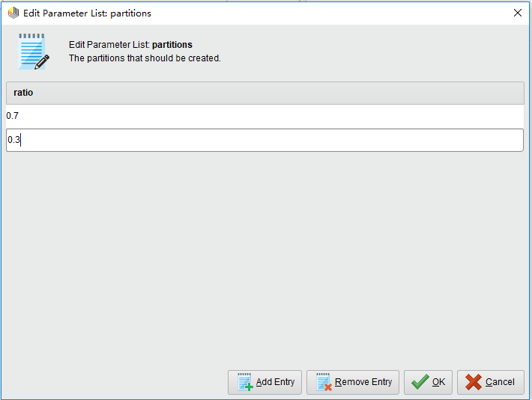
The proportion of the data
Notes:
click "Add Entry" twice. Enter 0.7 in the first line and 0.3 in the second line. Represents 70% of the data used to train the model and 30% of the data used to test the model. Finally, notice the connection between the operators.

Slide 20
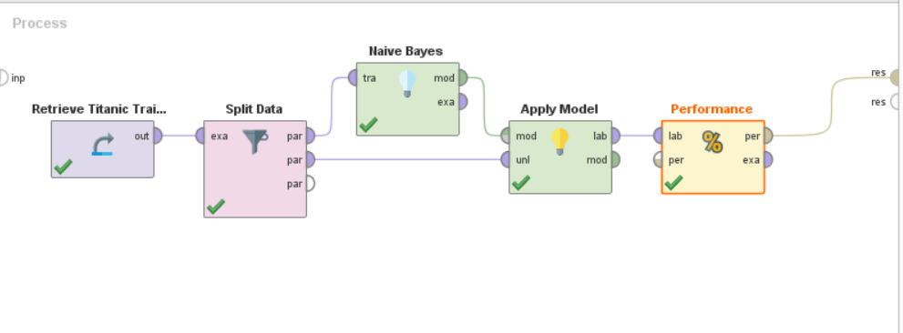
Final design

Slide 21
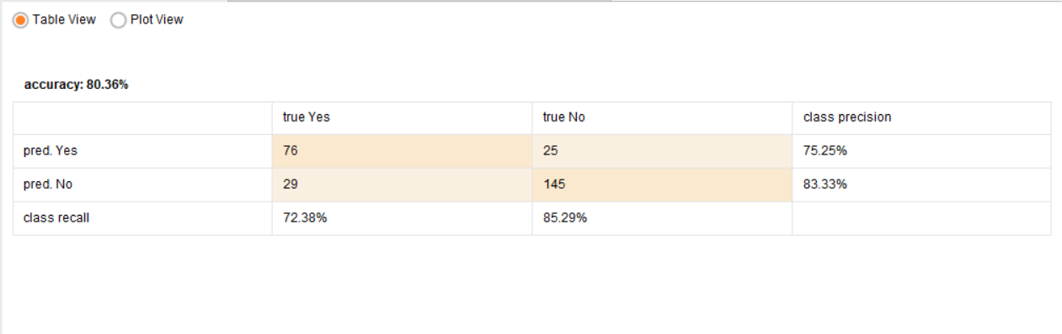
Result

Slide 22
Cross Validation

Slide 23
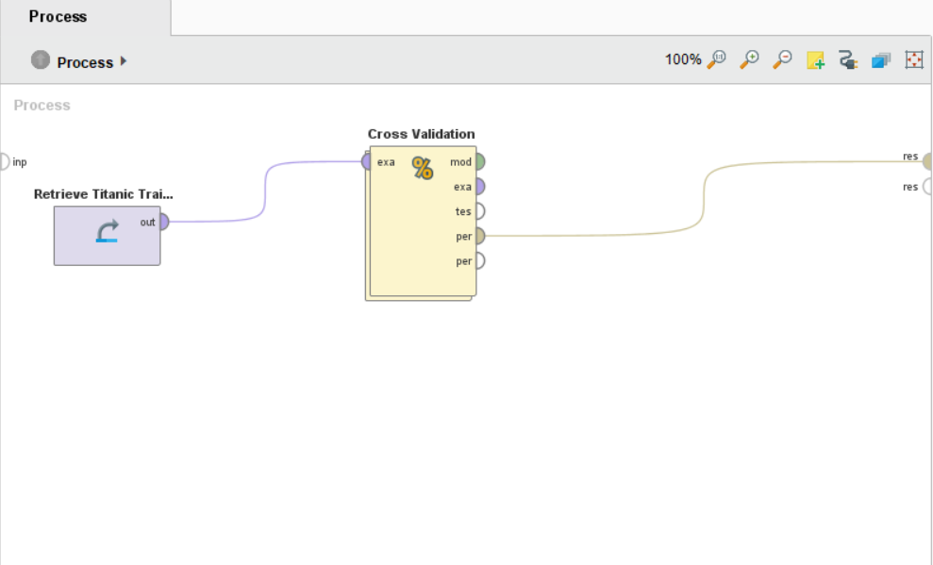
Outside
Notes:
Under the search box under "Operators", search for "Cross Validation" and then drag it into the action bar on the right. Double-clicking on the operator brings up internally nested processing operations, divided into "Training" and "Testing." In Training, add Model Training, and in Testing, add Apply Model. Also note the connection information here.

Slide 24
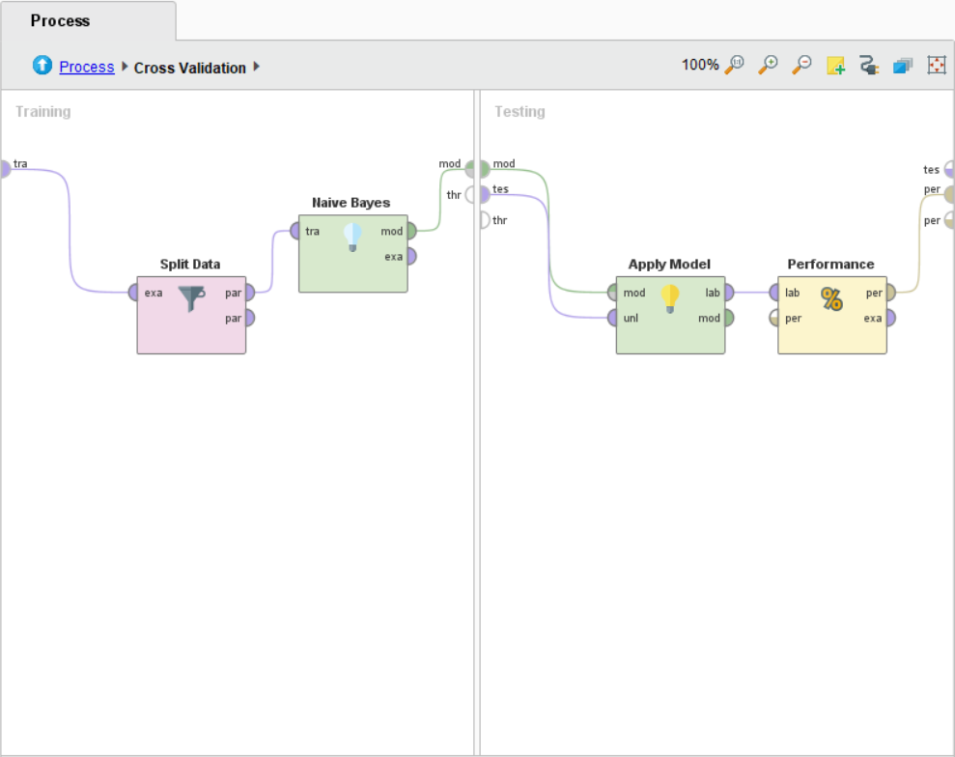
Inside the Cross Validation

Slide 25
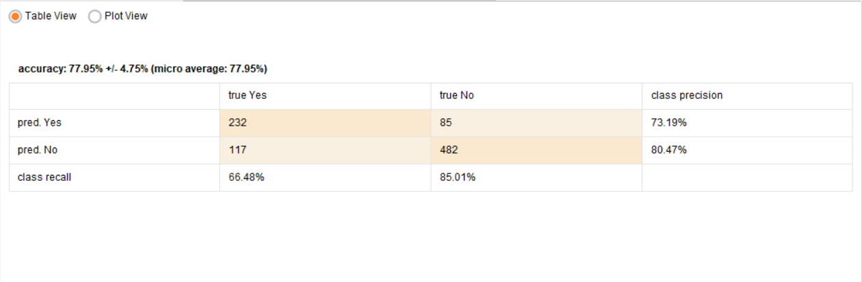
Result

Slide 26
Titanic Example from kaggle

Slide 27
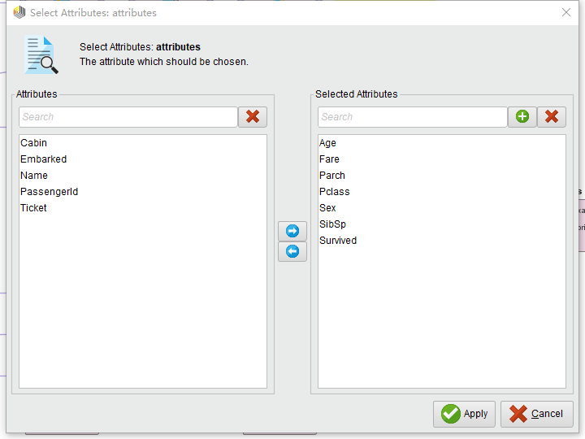
Choose the useful data
Notes:
Exploring the data set, you can find some features of the data set that are not useful for prediction. For example: PassengerId,Name, Ticket,, Cabin, Embarked.Select the "Select Attributes" operator from Rapid Miner, double-click the operator, and Select characteristics other than those above.

Slide 28
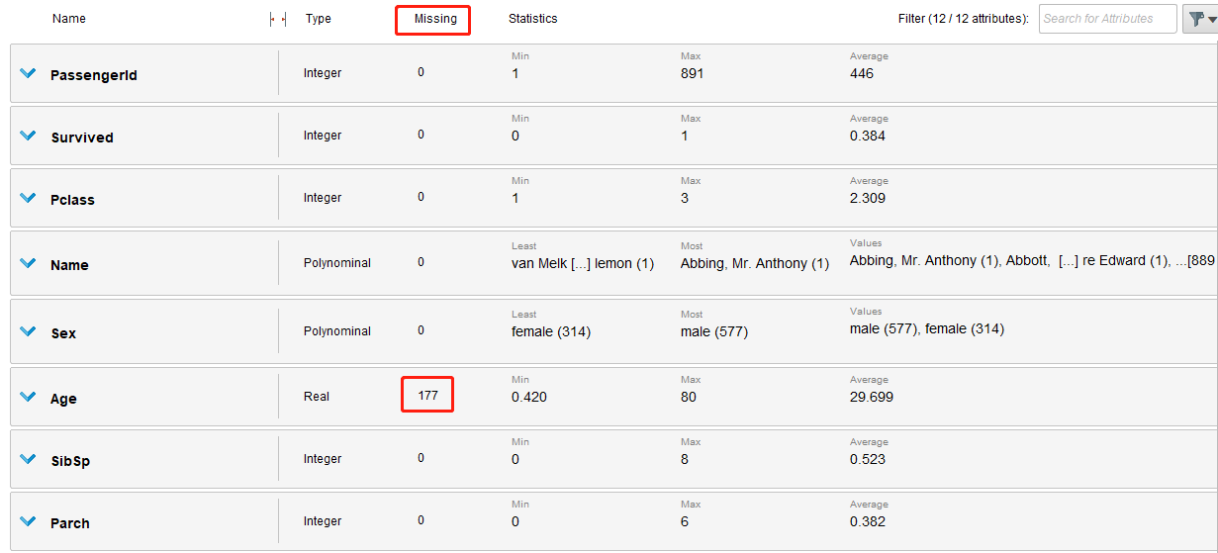
Process missing data
Notes:
After selecting useful data, statistics can find that the "Age" feature has lost data, as shown in the figure.

Slide 29
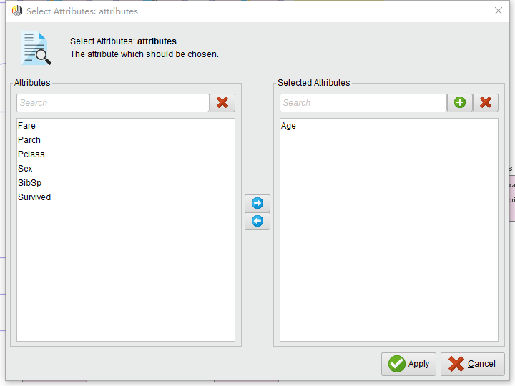
Notes:
To process the Missing data, select the "Replace Missing Value" operator from Rapid Miner, double-click the operator, and select the characteristic "Age" that needs to be performed.

Slide 30
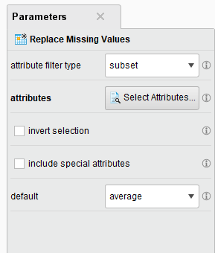
Then, in the right-hand column, select "average" to fill in the
missing data using the method of calculating the average.

Slide 31
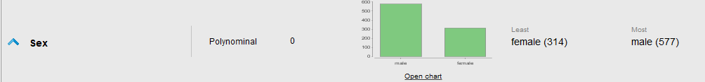
Processing non-digital data
Notes:
When statistical data set, can discover, "Sex" this characteristic is not numerical.

Slide 32
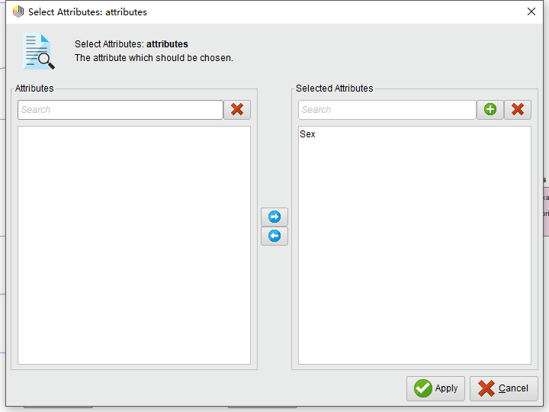
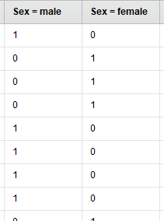
Notes:
At this time, "Norminal to Numerical" operator can be selected, and "Sex" feature can be selected to convert it into data similar to one-hot vector. The results are as follows:

Slide 33
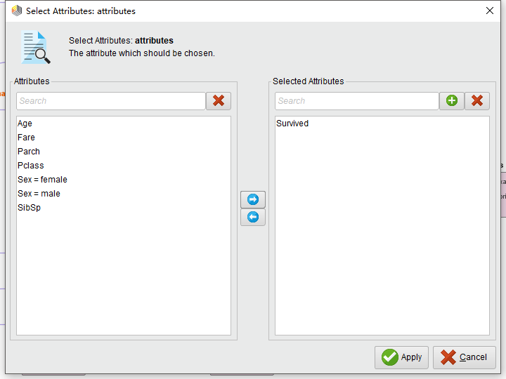
Converted data type
Notes:
The character of "Survived" is a numeric character, and here we need to process it into several types of data, 0 means dead and 1 means alive. Otherwise, Rapid Miner would have run a probability of survival, not a 0 or a 1. This does not meet Kaggle's submission requirements. At this point, select the operator "Numerical to polynominal" and then select "Survived" to process it into several categories of data.

Slide 34
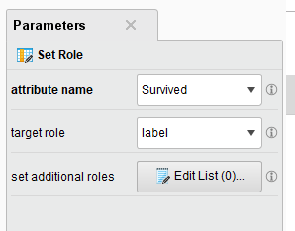
Set label data
In the training data set of Titanic, the feature of "Survived" is the label (target, label/target) data, so it needs to be set as label. You can use the "Set role" operator. Then set the "Survived" to "label".

Slide 35
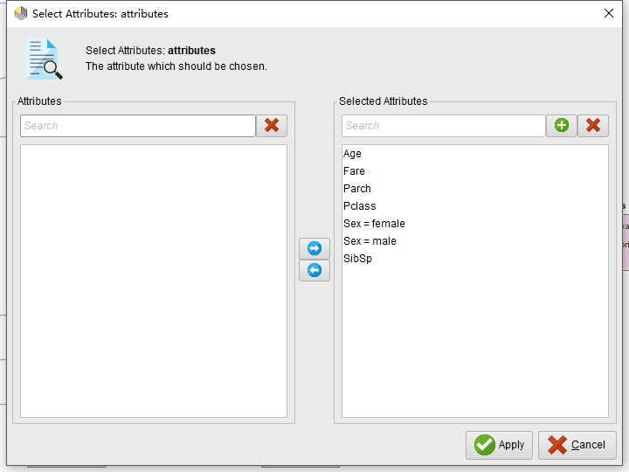
Standardized data
After the above steps are processed, feature reduction is followed and the data can be standardized. Select the "Normalize" operator, and then select the feature to process.

Slide 36
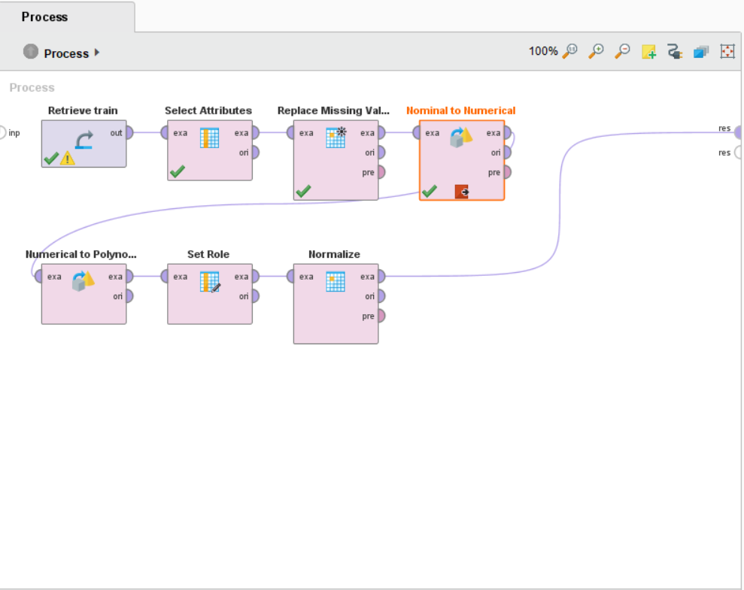
Final design(Train data)

Slide 37
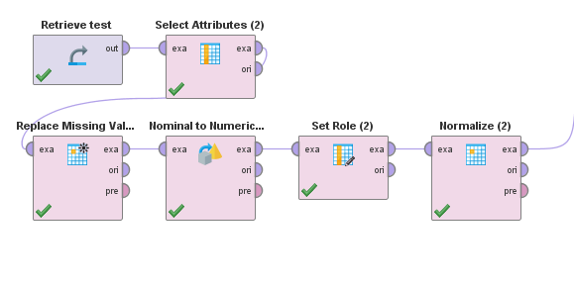
Final design(Test data)
Note, however, that when selecting a feature, PassengerId needs to be selected as well, as it will be used when exporting the result.
Notes:
Do the same for the test set data.

Slide 38
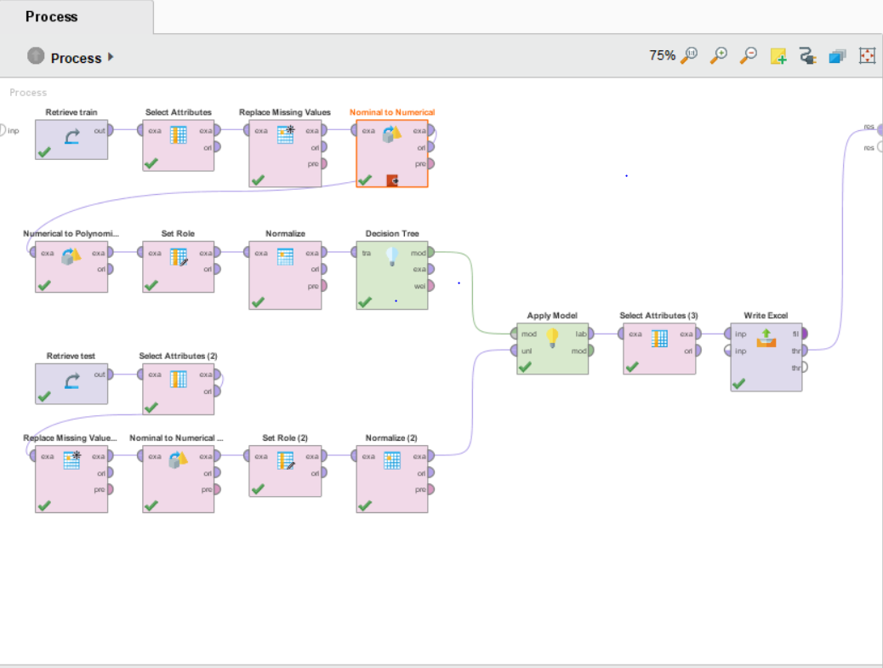
Build model(Train data)
Notes:
Choose "Decision Tree" operation, and then after processing the output of the training data set is connected to the input port of the operator, after training Model, to Apply it on the test set, then select "Apply the Model", will be treated as the output of the Model after training and test set after the output respectively with "Apply the Model" of the two input port connection, according to the requirements of Kaggle, only need to export "PassenerId" and "Prediction" (Survived) the two columns of data. So first Select these two Attributes using the "Select Attributes" operator, and then export them using the "Write Excel" operator

Slide 39
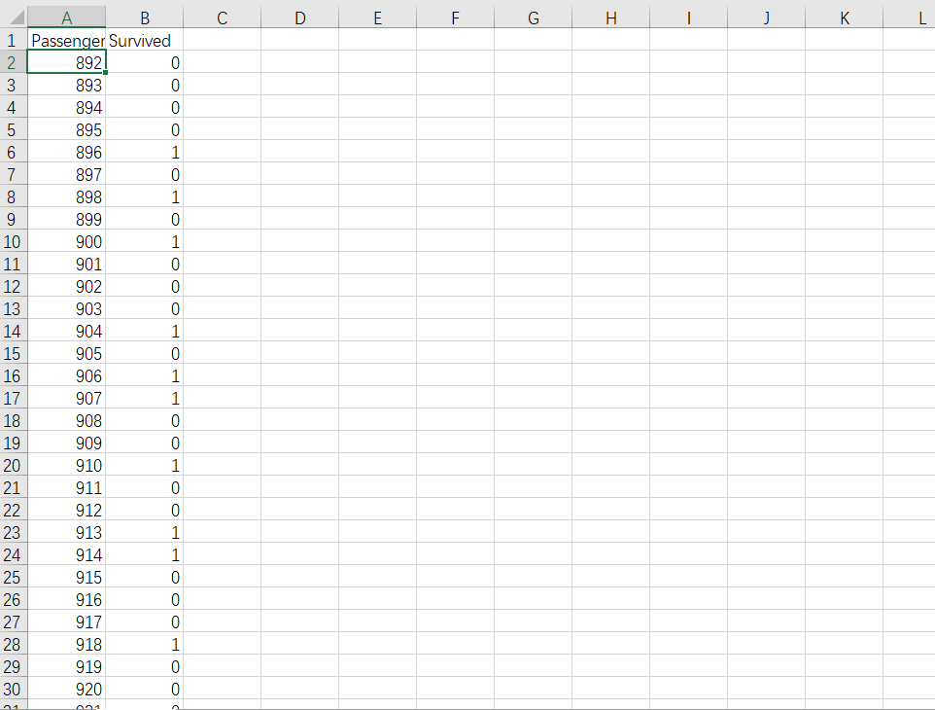
Result

